Slide 1


OCP 11 [1Z0-819]
Dr.-Ing Mohamed Amine Mezghich
Associate Professor at ENSI, CEO of Smart IT Partner
JAVA/J2EE Certified Trainer
ma.mezghich@smart-it-partner.com
amine.mezghich@ensi-uma.tn

Slide 2
Chapter 8 : IO
✓ Java I/O Fundamentals ■ Read and write data from the console ■ Use BufferedReader, BufferedWriter, FileReader, FileWriter, FileInputStream, FileOutputStream, ObjectOutputStream, ObjectInputStream, and PrintWriter in the java.io.package.

Slide 3
Chapter 8 : IO
This chapter focuses on using the java.io API to interact with files and streams. We start by describing how files and directories are organized within a file system and show how to access them with the java.io.File class. We then show how to read and write file data with the stream classes. Finally, we conclude this chapter by discussing ways of reading user input at runtime using the Console class. In the next chapter, “NIO.2,” we will revisit the discussion of files and show how Java now provides more powerful techniques for managing files.

Slide 4
1-Understanding Files and Directories
Conceptualizing the File System
1.1 ) Conceptualizing the File System
We begin this chapter by describing what a file is and what a directory is within a file system. We then present the java.io.File class and demonstrate how to use it to read and write file information.
A file is record within a file system that stores user and system data. Files are organized using directories. A directory is a record within a file system that contains files as well as other directories.
In order to interact with files, we need to connect to the file system. The file system is in charge of reading and writing data within a computer. Different operating systems use different file systems to manage their data. For example, Windows-based systems use a different file system than Unix-based ones.

Slide 5
1-Understanding Files and Directories
Conceptualizing the File System
1.1 ) Conceptualizing the File System
A path is a String representation of a file or directory within a file system. Each file system defines its own path separator character that is used between directory entries.
For example, the path value /user/home/zoo.txt means that the file zoo.txt is inside the home directory, with the home directory inside the user directory. You will see that paths can be absolute or relative later in this chapter.

Slide 6
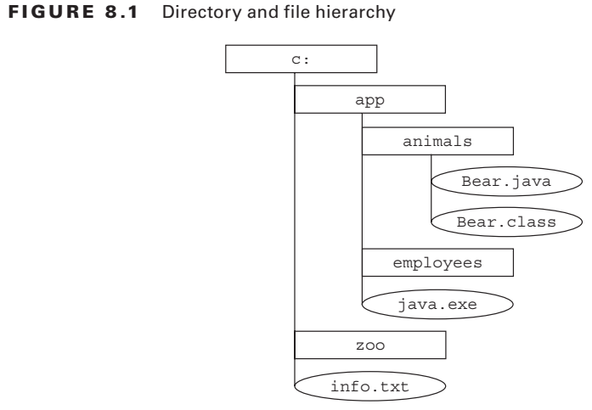
1-Understanding Files and Directories
Conceptualizing the File System
1.1 ) Conceptualizing the File System
We show how a directory and file system is organized in a hierarchical manner in Figure 8.1 . In this diagram, directories are represented as rectangles and files as ovals. Directories can be empty, as shown with the c:\zoo and c:\app\employees directories.

Slide 7
1-Understanding Files and Directories
Conceptualizing the File System
1.2 ) Introducing the File Class
The first class that we will discuss is one of the most commonly used in the java.io API, the java.io.File class, or File class for short. The File class is used a) to read information about existing files and directories, b) list the contents of a directory, and c)create/delete files and directories.
An instance of a File class represents the pathname of a particular file or directory on the file system. The File class cannot read or write data within a file, although it can be passed as a reference to many stream classes to read or write data, as you shall see in the next section. One common mistake new Java developers make is forgetting that the File class can be used to represent directories as well as files.

Slide 8
1-Understanding Files and Directories
Conceptualizing the File System
1.3 ) Creating a File Object A File object often is initialized with String containing either an absolute or relative path to the file or directory within the file system. The absolute path of a file or directory is the full path from the root directory to the file or directory, including all subdirectories that contain the file or directory. Alternatively, the relative path of a file or directory is the path from the current working directory to file or directory. For example, the following is an absolute path to the zoo.txt file: /home/smith/data/zoo.txt The following is a relative path to the same file, assuming the user’s current directory was set to /home/smith. data/zoo.txt

Slide 9
1-Understanding Files and Directories
Conceptualizing the File System
1.3 ) Creating a File Object A File object often is initialized with String containing either an absolute or relative path to the file or directory within the file system. The absolute path of a file or directory is the full path from the root directory to the file or directory, including all subdirectories that contain the file or directory. Alternatively, the relative path of a file or directory is the path from the current working directory to file or directory. For example, the following is an absolute path to the zoo.txt file: /home/smith/data/zoo.txt The following is a relative path to the same file, assuming the user’s current directory was set to /home/smith. data/zoo.txt

Slide 10
1-Understanding Files and Directories
1.3 ) Creating a File Object
Different operating systems vary in their format of path names. For example, Unix based systems use the forward slash / for paths, whereas Windows-based systems use the backslash \ character. That said, many programming languages and file systems support both types of slashes when writing path statements. For convenience, Java offers two options to retrieve the local separator character: a system property and a static variable defined in the File class. Both of the following examples will output the separator character:
System.out.println(System.getProperty("file.separator"));
System.out.println(java.io.File.separator);

Slide 11
1-Understanding Files and Directories
1.3 ) Creating a File Object
The following code creates a File object and determines if the path it references exists within the file system:
import java.io.File; public class FileSample { public static void main(String[] args) { File file = new File("/home/smith/data/zoo.txt"); System.out.println(file.exists()); } }

Slide 12
1-Understanding Files and Directories
1.3 ) Creating a File Object
This example uses the absolute path to a file and outputs true or false, depending on whether the file exists. The most common File constructor we will use throughout this chapter takes a single String as an argument representing the relative or absolute path. There are other constructors, such as the one that joins an existing File path with a relative child path, as shown in the following example:
File parent = new File("/home/smith"); File child = new File(parent,"data/zoo.txt");

Slide 13
1-Understanding Files and Directories
1.3 ) Creating a File Object
In this example, we create a path that is equivalent to our previous example, using a combination of a child path and a parent path. If the parent object happened to be null, then it would be skipped and the method would revert to our single String

Slide 14
1-Understanding Files and Directories
1.4 ) Working with a File Object The File class contains numerous useful methods for interacting with files and directories within the file system. We present the most commonly used ones in Table 8.1. Although this table may seem like a lot of methods to learn, many of them are self-explanatory. For example, exists() returns true if the file or directory path exists and false otherwise.

Slide 15
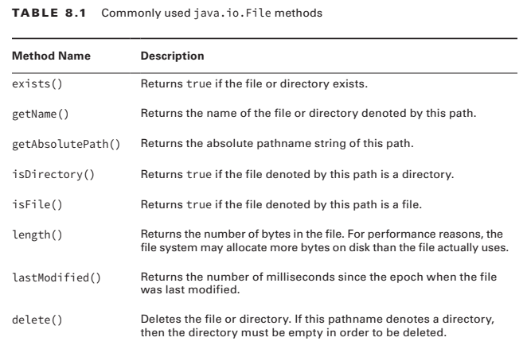
1-Understanding Files and Directories
1.4 ) Working with a File Object
Notes:
See Netbeans Project OCP, chapter8

Slide 16
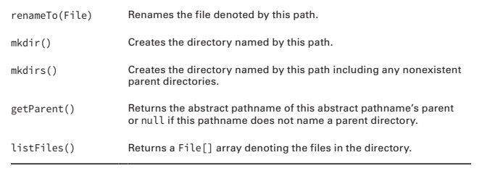
1-Understanding Files and Directories
1.4 ) Working with a File Object

Slide 17
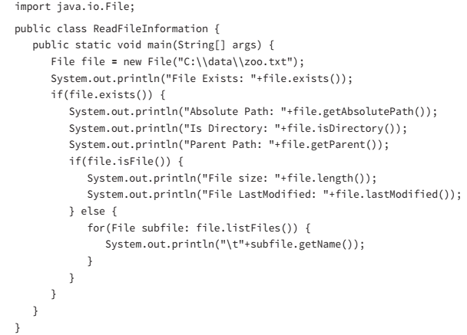
1-Understanding Files and Directories
1.4 ) Working with a File Object
The following is a sample program that given a file path outputs information about the file or directory, such as whether it exists, what files are contained within it, and so forth:

Slide 18
1-Understanding Files and Directories
1.4 ) Working with a File Object
In these examples, you see that the output of an I/O-based program is completely dependent on the directories and fi les available at runtime in the underlying fi le system. Note that we used a Windows-based path in the previous sample, which requires a double backslash in the String literal for the path separator. You may remember from Chapter 5 , “Dates, Strings and Localization,” that the backslash \ is a reserved character within a String literal and must be escaped with another backslash to be used within a String.

Slide 19
2-Introducing Streams
2.1 ) Stream Fundamentals In this section, we present the concept of streams in Java and show how they are used for input/output (I/O) processing. I/O refers to the nature of how data is accessed, either by reading the data from a resource (input), or writing the data to a resource (output). This section will focus on the common ways that data is input and output using fi les accessed by streams. Note that the I/O streams that we discuss in this chapter are data streams and completely unrelated to the new Stream API that you saw in Chapter 4 , “Functional Programming.” Even we agree that the naming of the new Stream API can be a little confusing when discussing I/O streams.

Slide 20
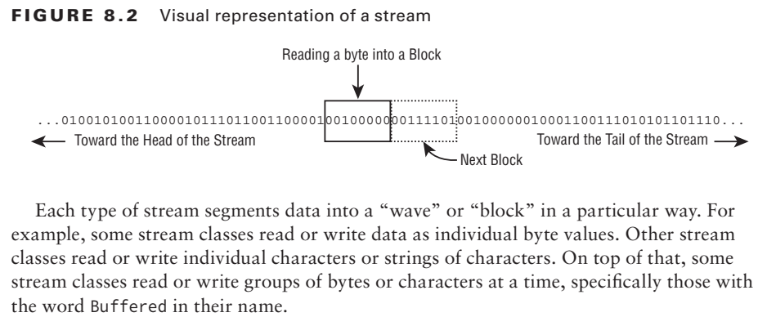
2-Introducing Streams
2.1 ) Stream Fundamentals The contents of a fi le may be accessed or written via a stream, which is a list of data elements presented sequentially. Streams should be conceptually thought of as a long, nearly never-ending “stream of water” with data presented one “wave” at a time.

Slide 21
2-Introducing Streams
2.2 ) Stream Nomenclature : Byte Streams vs. Character Streams
The java.io API defines two sets of classes for reading and writing streams: those with Stream in their name and those with Reader/Writer in their name. For example, the java.io API defines both a FileInputStream class as well as a FileReader class, both of which define a stream that reads a file. The difference between the two classes is based on how the stream is read or written.

Slide 22
2-Introducing Streams
2.2 ) Stream Nomenclature : Byte Streams vs. Character Streams
Differences between Streams and Readers/Writers
1. The stream classes are used for inputting and outputting all types of binary or byte data.
2. The reader and writer classes are used for inputting and outputting only character and String data.

Slide 23
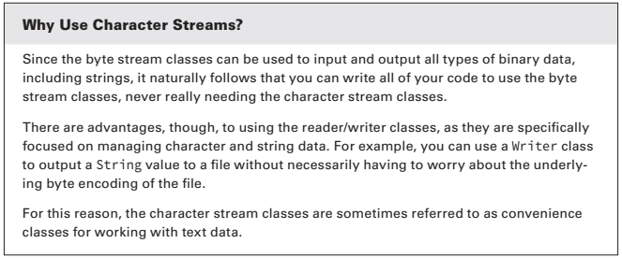
2-Introducing Streams
2.2 ) Stream Nomenclature : Byte Streams vs. Character Streams

Slide 24
2-Introducing Streams
2.2 ) Stream Nomenclature : Byte Streams vs. Character Streams
The java.io API is structured such that all of the stream classes have the word InputStream or OutputStream in their name, while all Reader/Writer classes have either Reader or Writer in their name.
Pay close attention to the name of the java.io class on the exam, as decoding it often gives you context clues as to what the class does. For example, without needing to look it up, it should be clear that FileReader is a class that reads data from a file as characters or strings. Furthermore, ObjectOutputStream sounds like a class that writes object data to a byte stream.

Slide 25
2-Introducing Streams
2.3 ) Input and Output Most Input stream classes have a corresponding Output class and vice versa. For example, the FileOutputStream class writes data that can be read by a FileInputStream. If you understand the features of a particular Input or Output stream class, you should naturally know what its complementary class does. It follows, then, that most Reader classes have a corresponding Writer class. For example, the FileWriter class writes data that can be read by a FileReader.
There are exceptions to this rule. For the exam, you should know that PrintWriter has no accompanying PrintReader class. Likewise, the PrintStream class has no corresponding InputStream class. We will discuss these classes later this chapter.

Slide 26
2-Introducing Streams
2.4 ) Low-Level vs. High-Level Streams Another way that you can familiarize yourself with the java.io API is by segmenting streams into low-level and high-level streams.
A low-level stream connects directly with the source of the data, such as a file, an array, or a String. Low-level streams process the raw data or resource and are accessed in a direct and unfiltered manner. For example, a FileInputStream is a class that reads file data one byte at a time.

Slide 27
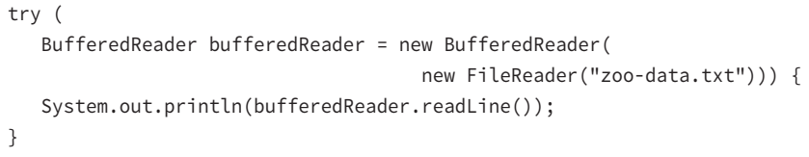
2-Introducing Streams
2.4 ) Low-Level vs. High-Level Streams Alternatively, a high-level stream is built on top of another stream using wrapping. For example, take a look at the FileWriter and BufferedWriter objects in the following sample code:

Slide 28
2-Introducing Streams
2.4 ) Low-Level vs. High-Level Streams FileReader is the low-level stream reader, whereas BufferedReader is the high-level stream that takes a FileReader as input. Many operations on the high-level stream pass through as operations to the underlying low-level stream, such as read() or close(). Other operations override or add new functionality to the low-level stream methods. The high level stream adds new methods, such as readLine(), as well as performance enhancements for reading and filtering the low-level data.

Slide 29
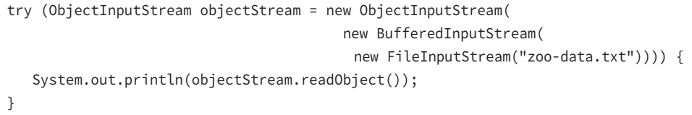
2-Introducing Streams
2.4 ) Low-Level vs. High-Level Streams High-level streams can take other high-level streams as input. For example, although the following code might seem a little odd at first, the style of wrapping a stream is quite common in practice:

Slide 30
2-Introducing Streams
2.4 ) Low-Level vs. High-Level Streams
In this example, FileInputStream is the low-level stream that interacts directly with the file, which is wrapped by a high-level BufferedInputStream to improve performance. Finally, the entire object is wrapped by a high-level ObjectInputStream, which allows us to filter the data as Java objects.

Slide 31
2-Introducing Streams
2.5 ) Stream Base Classes
The java.io library defines four abstract classes that are the parents of all stream classes defined within the API: InputStream, OutputStream, Reader, and Writer. For convenience, the authors of the Java API include the name of the abstract parent class as the suffix of the child class. For example, ObjectInputStream ends with InputStream, meaning it has InputStream as an inherited parent class. Although most stream classes in java.io follow this pattern, PrintStream, which is an OutputStream, does not.
The constructors of high-level streams often take a reference to the abstract class.
Notes:
Object,buffer,file input/outputstream ; the others file Reader/Witer

Slide 32
2-Introducing Streams
2.5 ) Stream Base Classes
One common area where the exam likes to play tricks on you is mixing and matching stream classes that are not compatible with each other. For example, take a look at each of the following examples and see if you can determine why they do not compile.

Slide 33
2-Introducing Streams
2.5 ) Stream Base Classes
new BufferedInputStream(new FileReader("zoo-data.txt")); // DOES NOT COMPILE
new BufferedWriter(new FileOutputStream("zoo-data.txt")); // DOES NOT COMPILE
new ObjectInputStream(new FileOutputStream("zoo-data.txt")); // DOES NOT COMPILE
new BufferedInputStream(new InputStream()); // DOES NOT COMPILE

Slide 34
2-Introducing Streams
2.6 ) Decoding Java I/O Class Names
Given that there are so many different java.io stream classes, it is reasonable to think that you might encounter one on the exam whose name you may have forgotten.
Luckily, the function of most stream classes can be understood by decoding the name of the class. We summarize these properties in the following list.

Slide 35
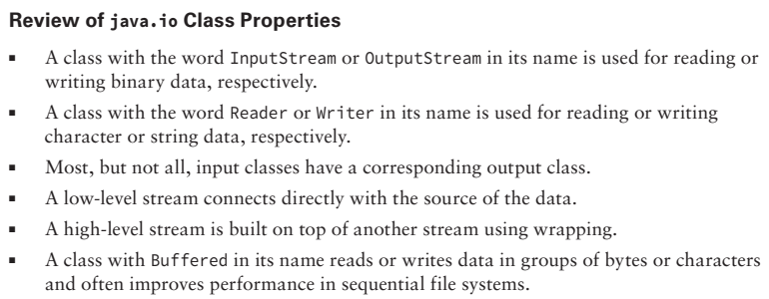
2-Introducing Streams
2.6 ) Decoding Java I/O Class Names

Slide 36
2-Introducing Streams
2.6 ) Decoding Java I/O Class Names
When wrapping a stream you can mix and match only types that inherit from the same abstract parent stream.
Table 8.2 describes those java.io streams you should be familiar with for the exam. Note that most of the information about each stream, such as whether it is an input or output stream or whether it accesses data using bytes or characters, can be decoded by the name alone.

Slide 37
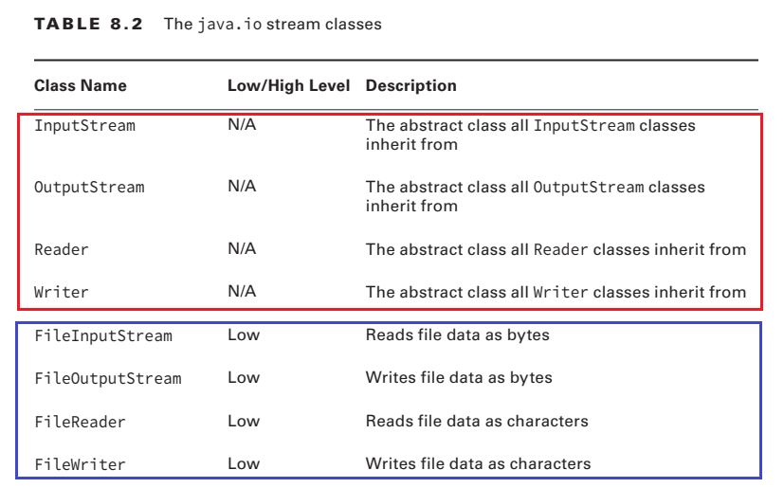
2-Introducing Streams
2.6 ) Decoding Java I/O Class Names

Slide 38
2-Introducing Streams
2.6 ) Decoding Java I/O Class Names

Slide 39
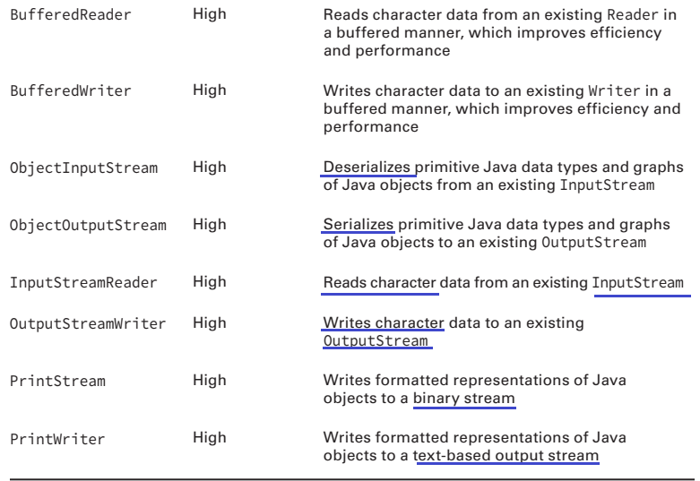
2-Introducing Streams
2.6 ) Decoding Java I/O Class Names

Slide 40
2-Introducing Streams
2.7 ) Common Stream Operations Let’s review some common processes when working with streams.
A) Closing the Stream Since streams are considered resources, it is imperative that they be closed after they are used lest they lead to resource leaks. As you saw in Chapter 6, “Exceptions and Assertions,” you can accomplish this by calling the close() method in a finally block or using the try-with-resource syntax. In a file system, failing to close a file properly could leave it locked by the operating system such that no other processes could read/write to it until the program is terminated. Throughout this chapter, we will close stream resources using the try-with-resource syntax, since this is the preferred way of closing resources in Java.

Slide 41
2-Introducing Streams
2.7 ) Common Stream Operations Let’s review some common processes when working with streams.
A) Closing the Stream Since streams are considered resources, it is imperative that they be closed after they are used lest they lead to resource leaks. As you saw in Chapter 6, “Exceptions and Assertions,” you can accomplish this by calling the close() method in a finally block or using the try-with-resource syntax. In a file system, failing to close a file properly could leave it locked by the operating system such that no other processes could read/write to it until the program is terminated. Throughout this chapter, we will close stream resources using the try-with-resource syntax, since this is the preferred way of closing resources in Java.

Slide 42
2-Introducing Streams
2.7 ) Common Stream Operations B)Flushing the Stream(1/3) When data is written to an OutputStream, the underlying operating system does not necessarily guarantee that the data will make it to the file immediately. In many operating systems, the data may be cached in memory, with a write occurring only after a temporary cache is filled or after some amount of time has passed. If the data is cached in memory and the application terminates unexpectedly, the data would be lost, because it was never written to the file system. To address this, Java provides a flush() method, which requests that all accumulated data be written immediately to disk.

Slide 43
2-Introducing Streams
2.7 ) Common Stream Operations B)Flushing the Stream(2/3) The flush() method helps reduce the amount of data lost if the application terminates unexpectedly. It is not without cost, though. Each time it is used, it may cause a noticeable delay in the application, especially for large files. Unless the data that you are writing is extremely critical, the flush() method should only be used intermittently. For example, it should not necessarily be called after every write but after every dozen writes or so, depending on your requirements. For reasonably small files, you may need to call flush() only once.

Slide 44
2-Introducing Streams
2.7 ) Common Stream Operations B)Flushing the Stream(3/3) You do not need to call the flush() method explicitly when you have finished writing to a file, since the close() method will automatically do this. In some cases, calling the flush() method intermittently while writing a large file, rather than performing a single large flush when the file is closed, may appear to improve performance by stretching the disk access over the course of the write process.

Slide 45
2-Introducing Streams
2.7 ) Common Stream Operations C) Marking the Stream(1/2) The InputStream and Reader classes include mark(int) and reset() methods to move the stream back to an earlier position. Before calling either of these methods, you should call the markSupported() method, which returns true only if mark() is supported. Not all java.io input stream classes support this operation, and trying to call mark(int) or reset() on a class that does not support these operations will throw an exception at runtime.

Slide 46
2-Introducing Streams
2.7 ) Common Stream Operations C) Marking the Stream(2/2)
Once you’ve verified that the stream can support these operations, you can call mark(int) with a read-ahead limit value. You can then read as many bytes as you want up to the limit value. If at any point you want to go back to the earlier position where you last called mark(), then you just call reset() and the stream will “revert” to an earlier state. In practice, it’s not actually putting the data back into the stream but storing the data that was already read into memory for you to read again. Therefore, you should not call the mark() operation with too large a value as this could take up a lot of memory.

Slide 47
2-Introducing Streams
2.7 ) Common Stream Operations C) Marking the Stream(2/2)
Once you’ve verified that the stream can support these operations, you can call mark(int) with a read-ahead limit value. You can then read as many bytes as you want up to the limit value. If at any point you want to go back to the earlier position where you last called mark(), then you just call reset() and the stream will “revert” to an earlier state. In practice, it’s not actually putting the data back into the stream but storing the data that was already read into memory for you to read again. Therefore, you should not call the mark() operation with too large a value as this could take up a lot of memory.

Slide 48
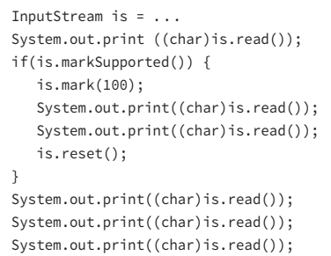

2-Introducing Streams
2.7 ) Common Stream Operations C) Marking the Stream(2/2)
Assume that we have an InputStream instance whose next values are ABCD. Consider the following code snippet:

Slide 49
2-Introducing Streams
2.7 ) Common Stream Operations D) Skipping over Data (1/2) The InputStream and Reader classes also include a skip(long) method, which as you might expect skips over a certain number of bytes. It returns a long value, which indicates the number of bytes that were actually skipped. If the return value is zero or negative, such as if the end of the stream was reached, no bytes were skipped.
Assume that we have an InputStream instance whose next values are TIGERS. Consider the following code snippet:

Slide 50
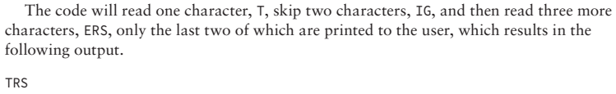
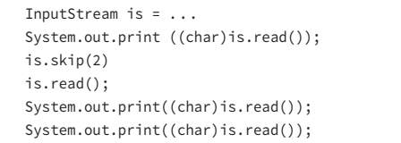
2-Introducing Streams
2.7 ) Common Stream Operations D) Skipping over Data (2/2)

Slide 51
3-Working with Streams
Now that we’ve reviewed the types of streams and their properties, it’s time to jump in and work with some stream code! Some of the techniques for accessing streams may seem a bit new to you, but as you will see they are very similar among different stream classes.

Slide 52
3-Working with Streams
3-1) The FileInputStream and FileOutputStream Classes (1) The first stream classes that we are going to discuss in detail are the most basic file stream classes, FileInputStream and FileOutputStream. They are used to read bytes from a file or write bytes to a file, respectively. These classes include constructors that take a File object or String, representing a path to the file.
The data in a FileInputStream object is commonly accessed by successive calls to the read() method until a value of -1 is returned, indicating that the end of the stream—in this case the end of the file—has been reached. Although less common, you can also choose to stop reading the stream early just by exiting the loop, such as if some search String is found.

Slide 53
3-Working with Streams
3-1) The FileInputStream and FileOutputStream Classes (2) The FileInputStream class also contains overloaded versions of the read() method, which take a pointer to a byte array where the data is written. The method returns an integer value indicating how many bytes can be read into the byte array.
A FileOutputStream object is accessed by writing successive bytes using the write(int) method. Like the FileInputStream class, the FileOutputStream also contains overloaded versions of the write() method that allow a byte array to be passed and can be used by Buffered classes. ➔The following code uses FileInputStream and FileOutputStream to copy a file:

Slide 54
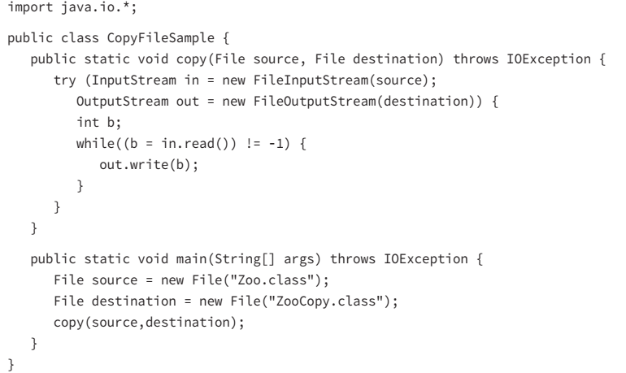
3-Working with Streams
3-1) The FileInputStream and FileOutputStream Classes (3)

Slide 55
3-Working with Streams
3-1) The FileInputStream and FileOutputStream Classes (4)
The copy() method creates instances of FileInputStream and FileOutputStream, and it proceeds to read the FileInputStream one byte at a time, copying the value to the FileOutputStream as it’s read. As soon as the in.read() returns a -1 value, the loop ends. Finally, both streams are closed using the try-with-resource syntax presented in Chapter 6. Note that the performance for this code, especially for large files, would not be particularly good because the sample does not use any byte arrays. As you shall see in the next section, we can improve the implementation using byte arrays and buffered streams.

Slide 56
3-Working with Streams
3-2) The BufferedInputStream and BufferedOutputStream Classes(1) We can enhance our implementation with only a few minor code changes by wrapping the FileInputStream and FileOutputStream classes that you saw in the previous example with the BufferedInputStream and BufferedOutputStream classes, respectively. Instead of reading the data one byte at a time, we use the underlying read(byte[]) method of BufferedInputStream, which returns the number of bytes read into the provided byte array. The number of bytes read is important for two reasons.

Slide 57
3-Working with Streams
3-2) The BufferedInputStream and BufferedOutputStream Classes(2) First, if the value returned is 0, then we know that we have reached the end of the file and can stop reading from the BufferedInputStream. Second, the last read of the file will likely only partially fill the byte array, since it is unlikely for the file size to be an exact multiple of our buffer array size.

Slide 58
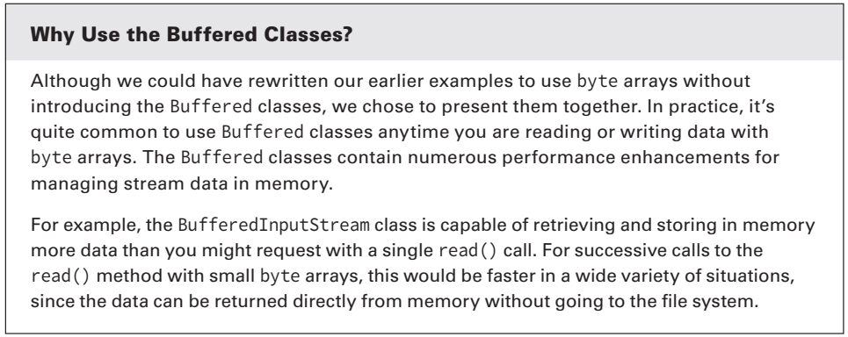
3-Working with Streams
3-2) The BufferedInputStream and BufferedOutputStream Classes(3)
For example, if the buffer size is 1,024 bytes and the file size is 1,054 bytes, then the last read will be only 30 bytes. The length value tells us how many of the bytes in the array were actually read from the file. The remaining bytes of the array will be filled with leftover data from the previous read that should be discarded.
The data is written into the BufferedOutputStream using the write(byte[],int,int) method, which takes as input a byte array, an offset, and a length value, respectively. The offset value is the number of values to skip before writing characters, and it is often set to 0. The length value is the number of characters from the byte array to write.

Slide 59
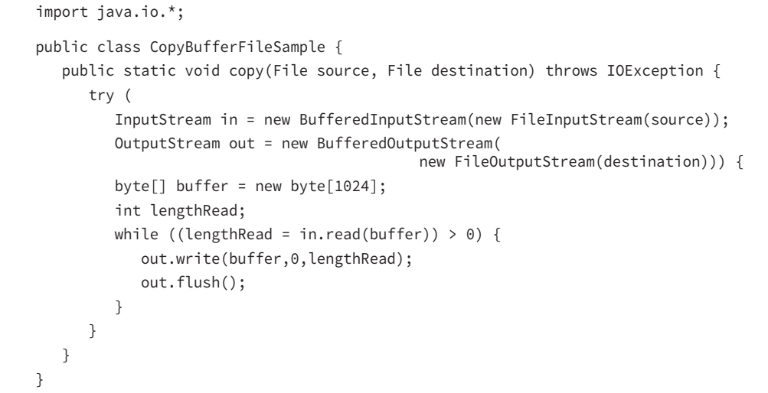
3-Working with Streams
3-2) The BufferedInputStream and BufferedOutputStream Classes(4) Here’s a modified form of our copy() method, which uses byte arrays and the Buffered stream classes:

Slide 60
3-Working with Streams
3-2) The BufferedInputStream and BufferedOutputStream Classes(4)
You can see that this sample code that uses byte arrays is very similar to the nonbuffered sample code, although the performance improvement for using both the Buffered classes and byte arrays is an order of magnitude faster in practice. We also added a flush() command in the loop, as previously discussed, to ensure that the written data actually makes it to disk before the next buffer of data is read.

Slide 61
3-Working with Streams
3-3) The FileReader and FileWriter classes (1)
The FileReader and FileWriter classes, along with their associated buffer classes, are among the most convenient classes in the java.io API, in part because reading and writing text data are among the most common ways that developers interact with files. Like the FileInputStream and FileOutputStream classes, the FileReader and FileWriter classes contain read() and write() methods, respectively.

Slide 62
3-Working with Streams
3-3) The FileReader and FileWriter classes (2)
These methods read/write char values instead of byte values; although similar to what you saw with streams, the API actually uses an int value to hold the data so that -1 can be returned if the end of the file is detected.
The FileReader and FileWriter classes contain other methods that you saw in the stream classes, including close() and flush(), the usage of which is the same.
The Writer class, which FileWriter inherits from, offers a write(String) method that allows a String object to be written directly to the stream. Using FileReader also allows you to pair it with BufferedReader in order to use the very convenient readLine() method, which you will see in the next example.

Slide 63
3-Working with Streams
3-4) The BufferedReader and BufferedWriter Classes (1) Let’s take a look at a sample program that makes use of both the BufferedReader and BufferedWriter classes using the associated readLine() and write(String) methods. It reads a text file, outputs each line to screen, and writes a copy of the file to disk. Since these classes are buffered, you can expect better performance than if you read/wrote each character one at a time.

Slide 64
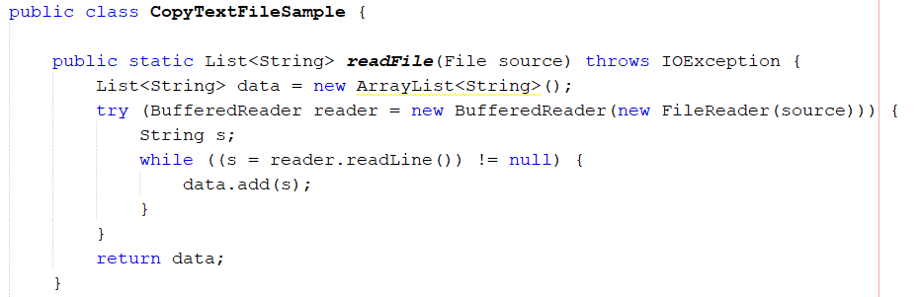
3-Working with Streams
3-4) The BufferedReader and BufferedWriter Classes (Example)

Slide 65
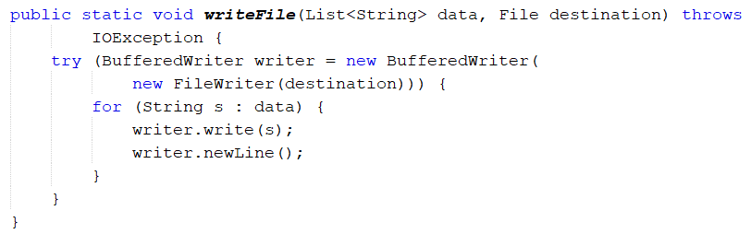
3-Working with Streams
3-4) The BufferedReader and BufferedWriter Classes (Example)

Slide 66
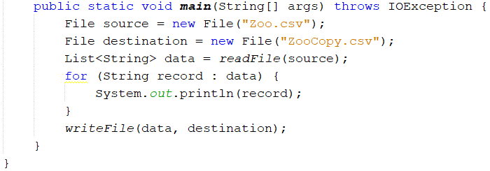
3-Working with Streams
3-4) The BufferedReader and BufferedWriter Classes (Example)

Slide 67
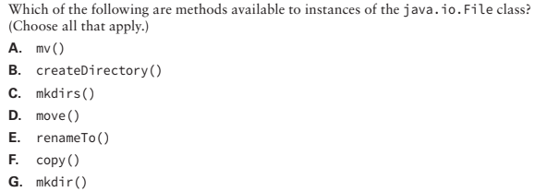
3-Working with Streams
Review Questions(1)
C, E, G. To move a file using java.io.File, you should use the renameTo() method, since there are no move() or mv() methods. Therefore, E is correct, and A and D are incorrect. To create a directory or chain of directories using java.io.File, you should use mkdir() or mkdirs(), respectively, because there is no createDirectory() method. Therefore, C and G are correct, and B is incorrect. Finally, there is no copy() method in the java. io.File class, so F is incorrect. Copying a file with java.io would require reading the contents using a stream
Notes:
Q11;
C, E, G. To move a file using java.io.File, you should use the renameTo() method, since there are no move() or mv() methods. Therefore, E is correct, and A and D are incorrect. To create a directory or chain of directories using java.io.File, you should use mkdir() or mkdirs(), respectively, because there is no createDirectory() method. Therefore, C and G are correct, and B is incorrect. Finally, there is no copy() method in the java. io.File class, so F is incorrect. Copying a file with java.io would require reading the contents using a stream

Slide 68
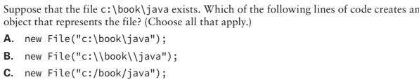

3-Working with Streams
Review Questions(2)
B, C. Option B is correct because Java requires a backslash to be escaped with another backslash. Option C is also correct because Java will convert the slashes to the right one when working with paths.
Notes:
Q12

Slide 69
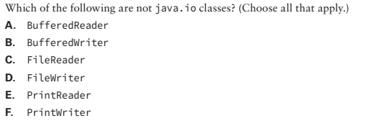
3-Working with Streams
Review Questions(3)
E. PrintWriter is the only Writer class that you need to know that doesn’t have a complementary Reader class, so E is correct.
Notes:
Q14

Slide 70
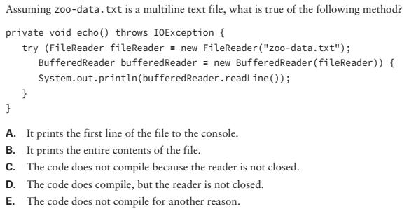
3-Working with Streams
This code compiles and runs without issue, so C and E are incorrect.
It uses a try-withresource block to open the FileReader and BufferedReader objects.
Therefore, both get closed automatically, and D is incorrect. The body of the try block reads in the first line of the file and outputs it to the user. Therefore, A is correct. Since the rest of the file is not read, B is incorrect.
Review Questions(4)
Notes:
Q15

Slide 71
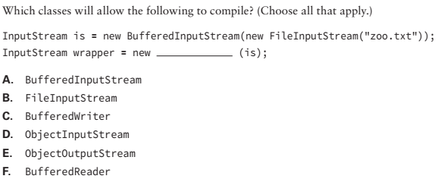
3-Working with Streams
A, D. The reference is for an InputStream object, so only a high-level input Stream class is permitted. B is incorrect because FileInputStream is a low-level stream that interacts directly with a file resource, not a stream resource. C and F are incorrect because you cannot use BufferedReader/BufferedWriter directly on a stream. E is incorrect because the reference is to an InputStream, not an OutputStream. A and D are the only correct options. Note that a BufferedInputStream can be wrapped twice, since high-level streams can take other high-level streams.
Review Questions(5)
Notes:
Q1

Slide 72
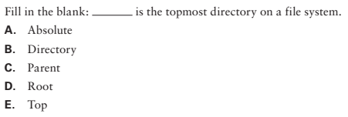
3-Working with Streams
Review Questions(6)
D. The root directory is the top-level directory; therefore D is correct. The rest of the statements are invalid or incorrect.
Notes:
Q7

Slide 73
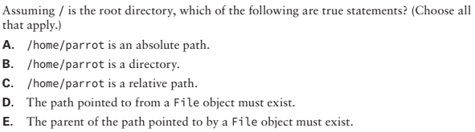
3-Working with Streams
Review Questions(7)
A. Paths that begin with the root directory are absolute paths, so A is correct and C is incorrect. B is incorrect because the path could be a file or directory within the file system. A File object may refer to a path that does not exist within the file system, so D and E are incorrect.
Notes:
Q8

Slide 74
3-Working with Streams
3-5) Character encoding in Java
Java supports a wide variety of character encodings, ranging from ones that may use one byte for Latin characters, UTF-8 and ASCII for example, to using two or more bytes per character, such as UTF-16. For the exam, you don’t need to memorize the character encodings, but you should be familiar with the names if you come across them on the exam.
Notes:
Q8

Slide 75
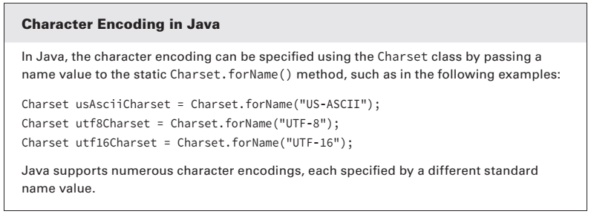
3-Working with Streams
3-5) Character encoding in Java
Notes:
Q8

Slide 76
3-Working with Streams
3-6) The ObjectInputStream and ObjectOutputStream Classes
Throughout this book, we have been managing our data model using classes, so it makes sense that we would want to write these objects to disk.
The process of converting an in-memory object to a stored data format is referred to as serialization, with the reciprocal process of converting stored data into an object, which is known as deserialization.
In this section, we will show you how Java provides built-in mechanisms for serializing and deserializing streams of objects directly to and from disk, respectively.
Notes:
Q8

Slide 77
3-Working with Streams
3-6) The ObjectInputStream and ObjectOutputStream Classes
The Serializable Interface(1)
In order to serialize objects using the java.io API, the class they belong to must implement the java.io.Serializable interface. The Serializable interface is a tagging or marker interface, which means that it does not have any methods associated with it. Any class can implement the Serializable interface since there are no required methods to implement.
Notes:
Q8

Slide 78
3-Working with Streams
3-6) The ObjectInputStream and ObjectOutputStream Classes
The Serializable Interface(2)
The purpose of implementing the Serializable interface is to inform any process attempting to serialize the object that you have taken the proper steps to make the object serializable, which involves making sure that the classes of all instance variables within the object are also marked Serializable.
Many of the built-in Java classes that you have worked with throughout this book, including the String class, are marked Serializable. This means that many of the simple classes that we have built throughout this book can be marked Serializable without any additional work.
Notes:
Q8

Slide 79
3-Working with Streams
3-6) The ObjectInputStream and ObjectOutputStream Classes
The Serializable Interface(3)
Note that the requirement for properly marking an object as Serializable may involve nested objects. For example, if a Cat class is marked as Serializable and contains a reference to a Tail object, then the class definition for the Tail object must also be marked as Serializable. Therefore, any object references contained within the Tail class must belong to classes that are also marked as Serializable, and so on.
Notes:
Q8

Slide 80
3-Working with Streams
3-6) The ObjectInputStream and ObjectOutputStream Classes
The Serializable Interface(4)
A process attempting to serialize an object will throw a NotSerializableException if the class or one of its contained classes does not properly implement the Serializable interface.
Let’s say that you have a particular object within a larger object that is not serializable, such as one that stores temporary state or metadata information about the larger object.
You can use the transient keyword on the reference to the object, which will instruct the process serializing the object to skip it and avoid throwing a NotSerializableException.
The only limitation is that the data stored in the object will be lost during the serialization process.
Notes:
Q8

Slide 81
3-Working with Streams
3-6) The ObjectInputStream and ObjectOutputStream Classes
The Serializable Interface(5)
Besides transient instance variables, static class members will also be ignored during the serialization and deserialization process. This should follow logically, as static class variables do not belong to one particular instance. If you need to store static class information, it will be need to be copied to an instance object and serialized separately.
Notes:
Q8

Slide 82
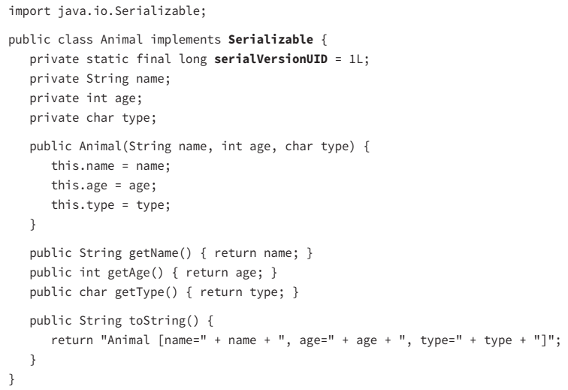
3-Working with Streams
3-6) The ObjectInputStream and ObjectOutputStream Classes
The Serializable Interface
Notes:
Q8

Slide 83
3-Working with Streams
3-6) The ObjectInputStream and ObjectOutputStream Classes
The Serializable Interface(6)
Notice that we also added a variable called serialVersionUID. Although this is certainly not required as part of implementing the Serializable interface, it is considered a good practice to do so and update this static class variable anytime you modify the class.
The serialization process uses the serialVersionUID to identify uniquely a version of the class. That way, it knows whether the serialized data for an object will match the instance variable in the current version of the class. If an older version of the class is encountered during deserialization, an exception may be thrown. Alternatively, some deserialization tools support conversions automatically.
Notes:
Q8

Slide 84
3-Working with Streams
3-6) The ObjectInputStream and ObjectOutputStream Classes
Serializing and Deserializing Objects (1)
The java.io API provides two stream classes for object serialization and deserialization called ObjectInputStream and ObjectOutputStream.
The ObjectOutputStream class includes a method to serialize the object to the stream called void writeObject(Object). If the provided object is a) not Serializable, or it b) contains an embedded reference to a class that is not Serializable or c) not marked transient, a NotSerializableException will be thrown at runtime.
Notes:
Q8

Slide 85
3-Working with Streams
3-6) The ObjectInputStream and ObjectOutputStream Classes
Serializing and Deserializing Objects (2)
For the reciprocal process, the ObjectInputStream class includes a deserialization method that returns an object called readObject(). Notice that the return type of this method is the generic type java.lang.Object, indicating that the object will have to be cast explicitly at runtime to be used.
We now provide a sample program that reads and writes Animal data objects:
Notes:
Q8

Slide 86
3-Working with Streams
public static List<Animal> getAnimals(File dataFile) throws IOException,
ClassNotFoundException {
List<Animal> animals = new ArrayList<Animal>();
try (ObjectInputStream in = new ObjectInputStream(
new BufferedInputStream(new FileInputStream(dataFile)))) {
while (true) {
Object object = in.readObject();
if (object instanceof Animal) {
animals.add((Animal) object);
}
}
} catch (EOFException e) {
// File end reached
}
return animals;
}
3-6) The ObjectInputStream and ObjectOutputStream Classes
Notes:
Q8

Slide 87
3-Working with Streams
public static void createAnimalsFile(List<Animal> animals, File dataFile)
throws IOException {
try (ObjectOutputStream out = new ObjectOutputStream(
new BufferedOutputStream(new FileOutputStream(dataFile)))) {
for (Animal animal : animals) {
out.writeObject(animal);
}
}
}
3-6) The ObjectInputStream and ObjectOutputStream Classes
Notes:
Q8

Slide 88
3-Working with Streams
public static void main(String[] args) throws IOException, ClassNotFoundException {
List<Animal> animals = new ArrayList<Animal>();
animals.add(new Animal("Tommy Tiger", 5, 'T'));
animals.add(new Animal("Peter Penguin", 8, 'P'));
File dataFile = new File("animal.data");
createAnimalsFile(animals, dataFile);
System.out.println(getAnimals(dataFile));
}
3-6) The ObjectInputStream and ObjectOutputStream Classes
Notes:
Q8

Slide 89
3-Working with Streams
From a high-level, the program first creates a list of Animal objects in memory that includes two Animal instances. It then writes the list data into memory to an animal.data file saved in the current working directory. Finally, it reads the data from the file and outputs the following text: [Animal [name=Tommy Tiger, age=5, type=T], Animal [name=Peter Penguin, age=8, type=P]]
Next, the readObject() throws the checked exception, ClassNotFoundException, since the class of the deserialized object may not be available to the JRE.
We conclude our discussion of the Object stream classes by noting that they do support reading and writing null objects. Therefore, it is important to check for null values when reading from a serialized data stream. In our sample application, we rely on the property of the instanceof operator always to return false for null values to skip explicitly needing to check for null values.
3-6) The ObjectInputStream and ObjectOutputStream Classes
Notes:
Q8

Slide 90
3-Working with Streams
3-7) Understanding Object Creation For the exam, you need be aware of how a deserialized object is created. When you deserialize an object, the constructor of the serialized class is not called. In fact, Java calls the first no-arg constructor for the first non-serializable parent class, skipping the constructors of any serialized class in between.
➔Furthermore, any static variables or default initializations are ignored.
Let’s take a look at a modified version the Animal class and see how the output of the ObjectStreamSample program would change with some modifications to our attributes and add a new constructor:
Notes:
Q8

Slide 91
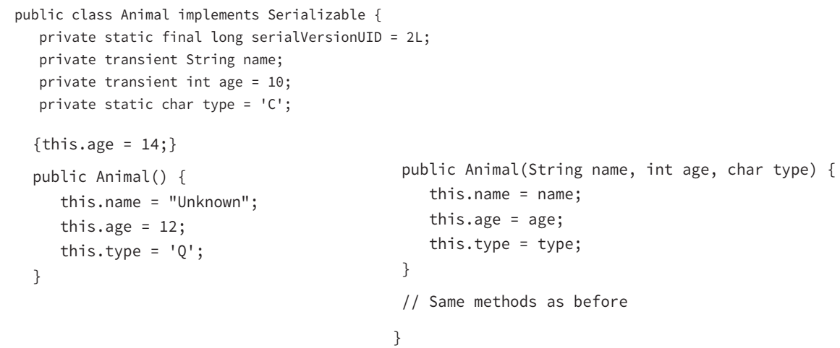
3-Working with Streams
3-7) Understanding Object Creation
Notes:
transient is a variables modifier used in serialization. At the time of serialization, if we don’t want to save value of a particular variable in a file, then we use transient keyword. When JVM comes across transient keyword, it ignores original value of the variable and save default value of that variable data type.

Slide 92
3-Working with Streams
3-7) Understanding Object Creation
As expected, you can see that the values for name and age are lost on serialization and not set again during deserialization. The JVM initializes these variables with the default values based on the data types String and int, which are null and 0, respectively. Since the type variable is static, it is not serialized to disk. The sample program displays a value for type, as the variable is shared by all instances of the class and is the last value in our sample program.
For the exam, make sure that you understand that the constructor and any default initializations are ignored during the deserialization process.

Slide 93
3-Working with Streams
3-8) The PrintStream and PrintWriter Classes
The PrintStream and PrintWriter classes are high-level stream classes that write formatted representation of Java objects to a text-based output stream. As you may have ascertained by the name, the PrintStream class operates on OutputStream instances and writes data as bytes, whereas the PrintWriter class operates on Writer instances and writes data as characters.
For convenience, both of these classes include constructors that can open and write to files directly. Furthermore, the PrintWriter class even has a constructor that takes an OutputStream as input, allowing you to wrap a PrintWriter class around an OutputStream.

Slide 94
3-Working with Streams
3-8) The PrintStream and PrintWriter Classes
For the exam, you should be aware that System.out and System.err are actually PrintStream objects.
Because PrintStream inherits OutputStream and PrintWriter inherits from Writer, both support the underlying write() method while providing a slew of print-based methods. For the exam, you should be familiar with the print(), println(), format(), and printf() methods. Unlike the underlying write() method, which throws a checked IOException that must be caught in your application, these print-based methods do not throw any checked exceptions. If they did, you would have been required to catch a checked exception anytime you called System.out.println() in your code .

Slide 95
3-Working with Streams
3-8) The PrintStream and PrintWriter Classes
3-8-1) print
The most basic of the print-based methods is print(), which is overloaded with all Java primitives as well as String and Object. In general, these methods perform String.valueOf() on the argument and call the underlying stream’s write() method, although they also handle character encoding automatically. For example, the following sets of print/write code are equivalent:
PrintWriter out = new PrintWriter("zoo.log"); out.print(5); // PrintWriter method out.write(String.valueOf(5)); // Writer method

Slide 96
3-Working with Streams
3-8) The PrintStream and PrintWriter Classes
3-8-2) println() The next methods available in the PrintStream and PrintWriter classes are the println() methods, which are virtually identical to the print() methods, except that they insert a line break after the String value is written. The classes also include a version of println() that takes no arguments, which terminates the current line by writing a line separator.
These methods are especially helpful, as the line break or separator character is JVM dependent. For example, in some systems a line feed symbol, \n, signifies a line break, whereas other systems use a carriage return symbol followed by a line feed symbol, \r\n, to signify a line break.
As you saw earlier in the chapter with file.separator, the line. separator value is available as a Java system property at any time: System.getProperty("line.separator");

Slide 97
3-Working with Streams
3-8) The PrintStream and PrintWriter Classes
3-8-3) format() and printf() (1/2) Like the String.format() methods discussed in Chapter 5 , the format() method in PrintStream and PrintWriter takes a String, an optional locale, and a set of arguments, and it writes a formatted String to the stream based on the input. In other words, it is a convenience method for formatting directly to the stream. Refer to Chapter 5 for more details about how String values can be formatted in Java.

Slide 98
3-Working with Streams
3-8) The PrintStream and PrintWriter Classes
3-8-3) format() and printf() (2/2) For convenience, as well as to make C developers feel more at home in Java, the PrintStream and PrintWriter APIs also include a set of printf() methods, which are straight pass-through methods to the format() methods. For example, although the names of the following two methods differ, their input values, output value, and behavior are identical in Java. They can be used interchangeably: public PrintWriter format(String format, Object args. . .) public PrintWriter printf(String format, Object args. . .)

Slide 99
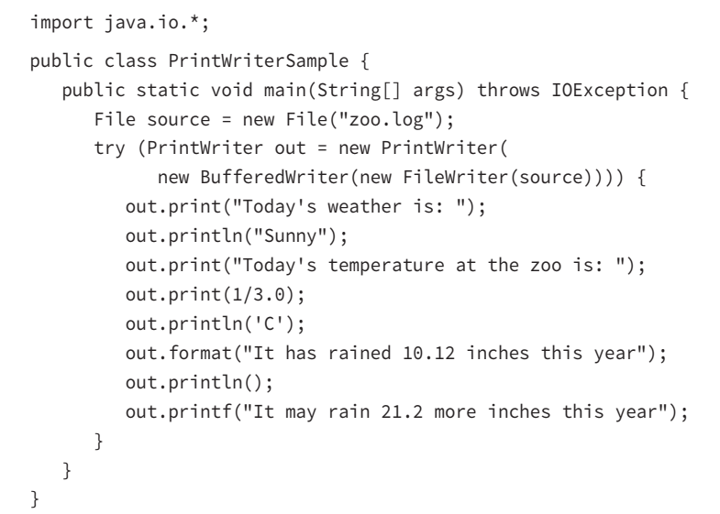
3-Working with Streams
3-8) The PrintStream and PrintWriter Classes
3-8-3) format() and printf() (2/2) Sample PrintWriter Application We conclude this section with sample code of the PrintWriter class in action, as well as the accompanying output file:

Slide 100
3-Working with Streams
3-9) Review of Stream Classes
We conclude this part of the chapter with Figure 8.3, which shows the various java. io stream classes that we have discussed and how they are related to one another via inheritance. The classes on the left side of the diagram are the abstract parent classes. The classes on the right side with dotted borders are low-level streams, and the ones with solid borders are high-level streams. Note that this diagram does not include all java.io stream classes, just the ones with which you should be familiar for the exam.

Slide 101
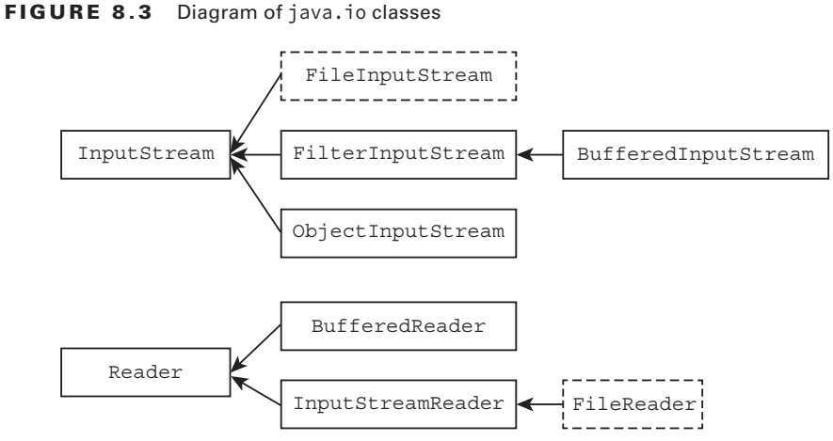
3-Working with Streams
3-9) Review of Stream Classes

Slide 102
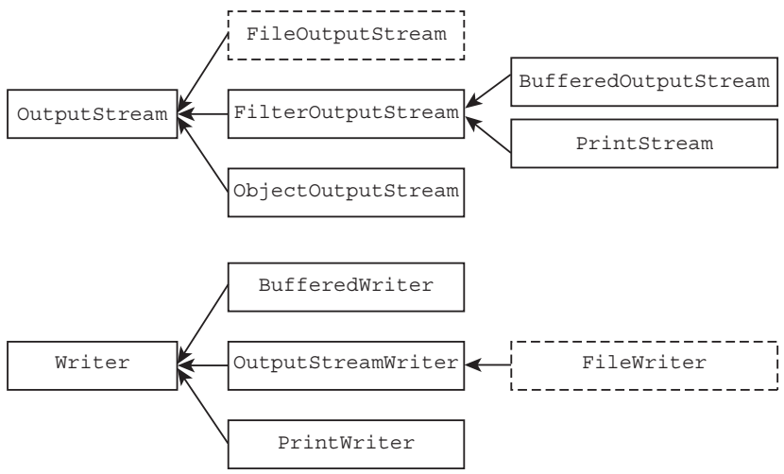
3-Working with Streams
3-9) Review of Stream Classes

Slide 103
3-Working with Streams
3-10) Other Stream Classes
The high-level InputStreamReader and OutputStreamWriter presented in Figure 8.3 are out of scope for the exam but useful in practice. The InputStreamReader class takes an InputStream instance and returns a Reader object. Likewise, the OutputStreamWriter class takes an OutputStream instance and returns a Writer object. In this manner, these classes convert data between character and byte streams. These classes are also unique in that they are the only java.io stream classes to have both Stream and Reader/Writer in their name.
The Filter classes are the superclass of all classes that filter or transform data. These classes will not be on the exam, though.

Slide 104
4-Interacting with Users
The java.io API includes numerous classes for interacting with the user. For example, you might want to write an application that asks a user to log in and reads their login details. In this section, we present the final java.io class that we will be covering in this book, the java.io.Console class, or Console class for short.
The Console class was introduced in Java 6 as a more evolved form of the System.in and System.out stream classes. It is now the recommended technique for interacting for interacting with and displaying information to the user in a text-based environment.

Slide 105
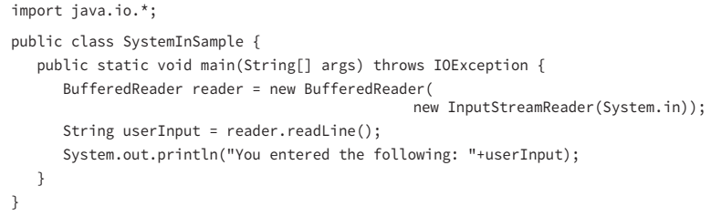
4-Interacting with Users
4-1)The Old Way
Before we delve into the Console class, let’s review the old way of obtaining text input from the user. Similar to how System.out returns a PrintStream and is used to output text data to the user, System.in returns an InputStream and is used to retrieve text input from the user. It can be chained to a BufferedReader to allow input that terminates with the Enter key. Before we can apply the BufferedReader, though, we need to wrap the System.in object using the InputStreamReader class, which allows us to build a Reader object out of an existing InputStream instance. The result is shown in the following application:

Slide 106
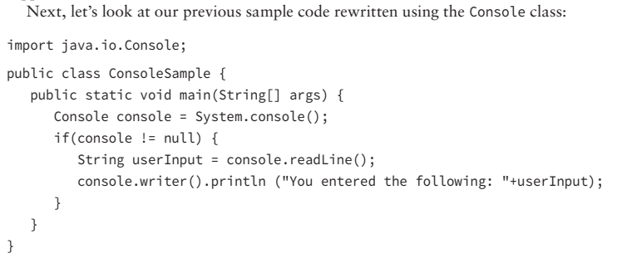
4-Interacting with Users
4-2)The New Way The System.in and System.out objects have been available since the earliest versions of Java. In Java 6, the java.io.Console class was introduced with far more features and abilities than the original techniques. After all, System.in and System.out are just raw streams, whereas Console is a class with multiple convenience methods, one that is capable of containing additional methods in the future. To begin, the Console class is a singleton, which as you may remember from Chapter 2 means that there is only one version of the object available in the JVM. It is created automatically for you by the JVM and accessed by calling the System.console() method.

Slide 107
4-Interacting with Users
4-2)The New Way The sample code first retrieves an instance of the Console singleton and determines if the Console is available by checking it for a null value. If the Console is available, it then retrieves a line of input from the user using the readLine() method, and it outputs the result using the Console’s built-in PrintWriter object, accessed via the writer() method. As you can see, the sample with System.in and System.out is very similar to the Console example by design. We will now review the various methods available in the Console class you should be familiar with for the exam, as well as note how the Console class has far more options than the System.in and System.out resources.

Slide 108
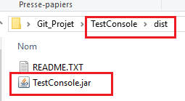
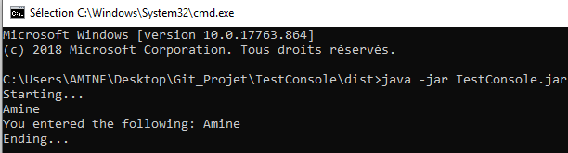
4-Interacting with Users
4-2)The New Way Steps to run the sample
1-Run>Build the project➔You obtain a .jar file
2-Run the command : java –jar TestConsole.jar

Slide 109
4-Interacting with Users
4-2)The New Way reader() and writer()
The Console class provides access to an instance of Reader and PrintWriter using the methods reader() and writer(), respectively. Access to these classes is analogous to calling System.in and System.out directly, although they use the Reader/Writer classes instead of the InputStream/OutputStream classes, which are more appropriate for working with character and String data. In this manner, they handle the underlying character encoding automatically.

Slide 110
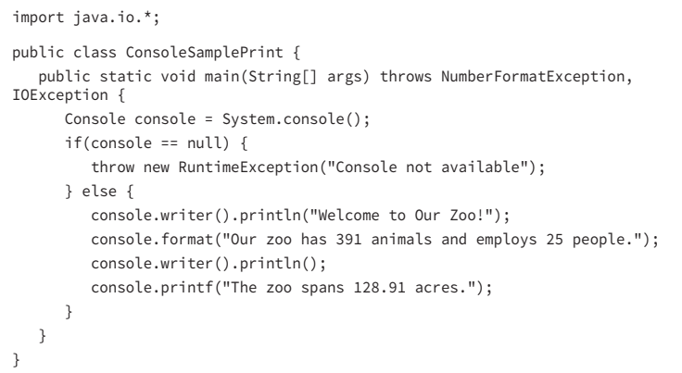
4-Interacting with Users
4-2)The New Way format() and printf() Note that the Console class defines only one format() method, and it does not define a format() method that takes a locale variable. In this manner, it uses the default system locale to establish the formatter. Of course, you could always use a custom locale by retrieving the Writer object and passing your own locale instance, such as in the following example: Console console = System.console(); console.writer().format(new Locale("fr", "CA"),"Hello World");

Slide 111
4-Interacting with Users
4-2)The New Way flush() The flush() method forces any buffered output to be written immediately. It is recommended that you call the flush() method prior to calling any readLine() or readPassword() methods in order to ensure that no data is pending during the read. Failure to do so could result in a user prompt for input with no preceding text, as the text prior to the prompt may still be in a buffer.

Slide 112
4-Interacting with Users
4-2)The New Way readLine() The basic readLine() method retrieves a single line of text from the user, and the user presses the Enter key to terminate it. The Console class also supports an overloaded version of the readLine() method with the signature readLine(String format, Object... args), which displays a formatted prompt to the user prior to accepting text.

Slide 113
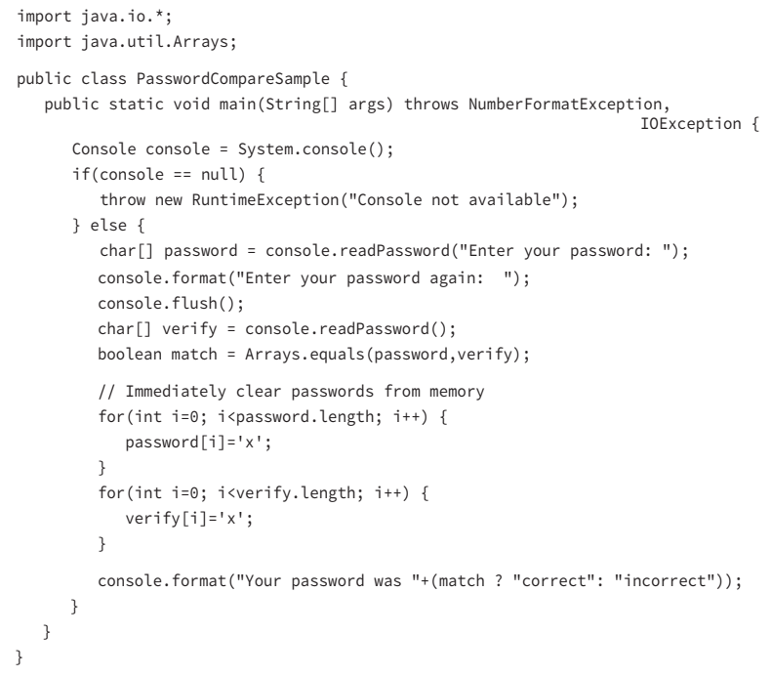
4-Interacting with Users
4-2)The New Way readPassword() The readPassword() method is similar to the readLine() method, except that echoing is disabled. By disabling echoing, the user does not see the text they are typing, meaning that their password is secure if someone happens to be looking at their screen. Also like the readLine() method, the Console class offers an overloaded version of the readPassword() method with the signature readPassword(String format, Object... args) used for displaying a formatted prompt to the user prior to accepting text. Unlike the readLine() method, though, the readPassword() method returns an array of characters instead of a String.

